Slide 1

01
BLOCKCHAIN | MARCH 2021
BLOCKCHAIN
PROJECT
GROUP 9
GROUP MEMBERS:
Leslie Korah Chally (B2019023)
Ashutosh Agrawal (B2019071)
Mudit Kanodia (B2019081)
Shikhar Bhagoliwal (B2019100)

Slide 2

02
PRESENTATION HIGHLIGHTS
Overview
Problem Statement
Why Indian Government needs Blockchain?
Coin Specification
Process Flow
OTP Generation
Transaction
Validation Check
Exceptional Handling
Future Prospects
BLOCKCHAIN | MARCH 2021

Slide 3
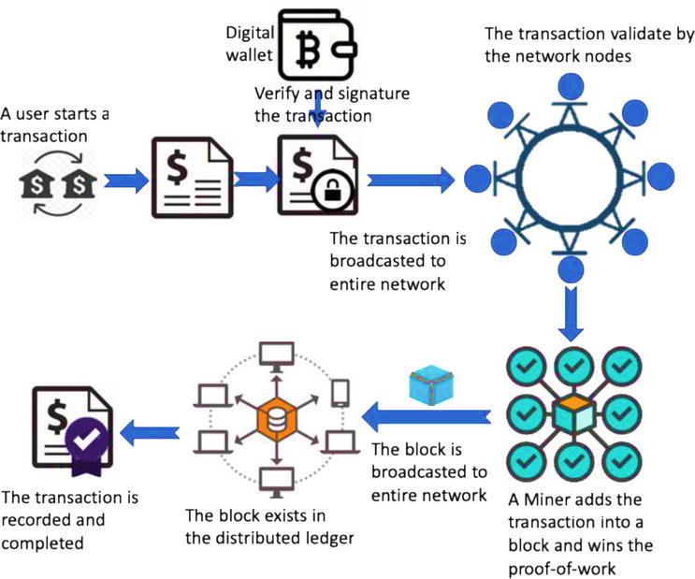

03
BLOCKCHAIN | MARCH 2021
OVERVIEW
Digital Wallet is used to store bitcoins or other cryptocurrencies that are bought by any user.
As the signature is cryptographically signed, transactions are highly secured.
Proof-of-work algorithm is used to confirm the transaction and creates a new block to the chain.

Slide 4

04
BLOCKCHAIN | MARCH 2021
PROBLEM STATEMENT
Indian Government has issued a set of virtual currency and it wants to track the transactions performed with it. So, in order to achieve this goal it has mandated to authenticate the transactions with a valid Pan Card ID.

Slide 5


WHY INDIAN GOVERNMENT NEEDS BLOCKCHAIN?
SECURE
INCREASED EFFICIENCY AND SPEED
TRANSPARENCY
ACCOUNTABILITY
REDUCED COST
05
BLOCKCHAIN | MARCH 2021

Slide 6

06
BLOCKCHAIN | MARCH 2021
COIN SPECIFICATION
Sender’s and receiver's pan card for verification and tracking
Email based OTP verification on registered email id (on the Pan Card) for added security
Sender’s and receiver’s name authentication

Slide 7





PROCESS FLOW
BLOCKCHAIN | MARCH 2021
07
CURRENT SCENARIO
IMPROVED VERSION
CONNECT NODES
CONSENSUS PROTOCOL
ADD TRANSACTION
TRANSACTION COMPLETE
MINE BLOCK
CONNECT NODES
CONSENSUS PROTOCOL
OTP GENERATION
TRANSACTION COMPLETE
MINE BLOCK
ADD TRANSACTION
PAN CARD
VERIFICATION
“A more secure, transparent chain needs to be implemented”

Slide 8
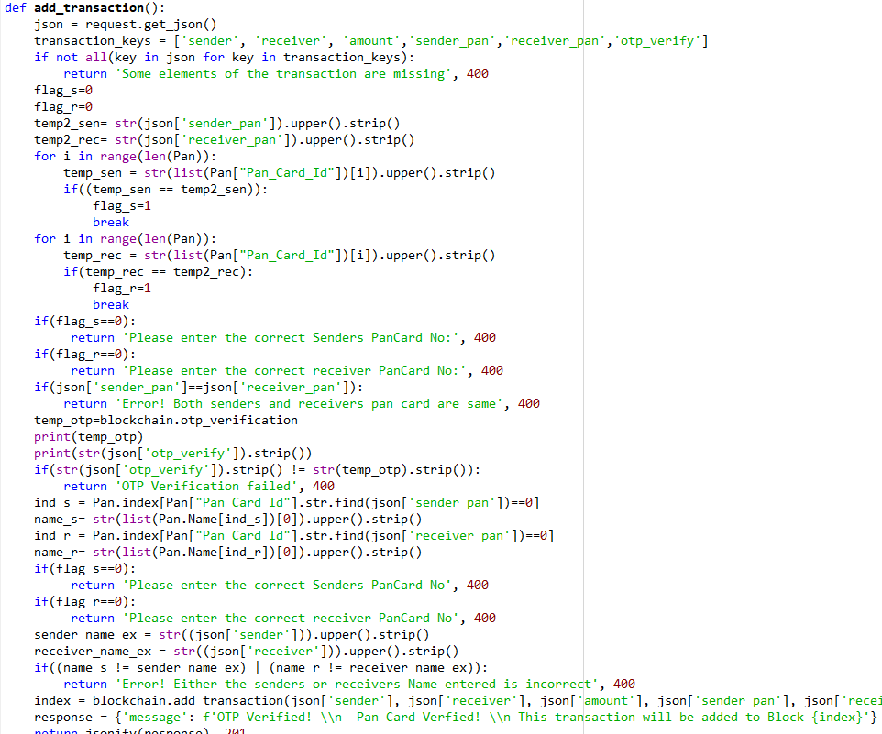
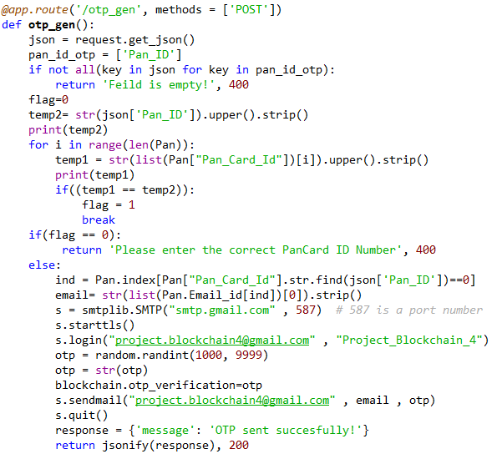
BLOCKCHAIN | MARCH 2021
08
CODE SNIPPET
OTP GENERATION
VERIFICATION
OTP GENERATION

Slide 9
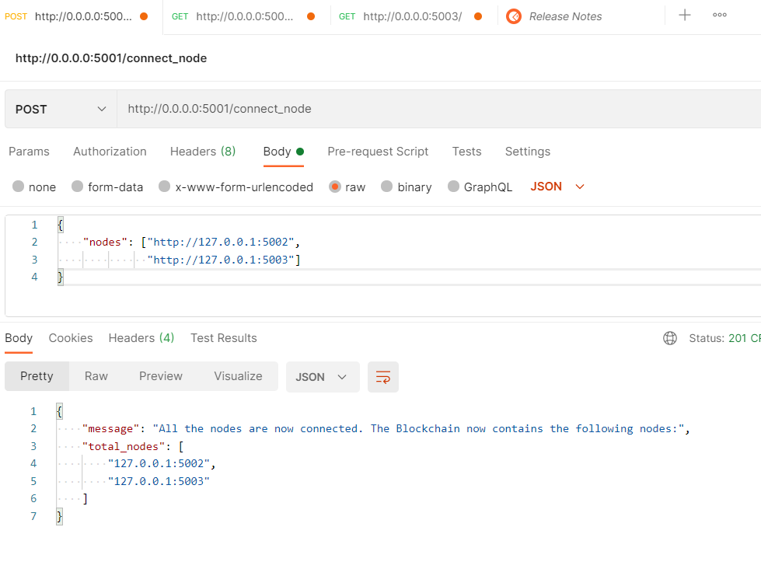

09
BLOCKCHAIN | MARCH 2021
CONNECTING NODE
Note: All the nodes must be interconnected before any transaction or other processes

Slide 10
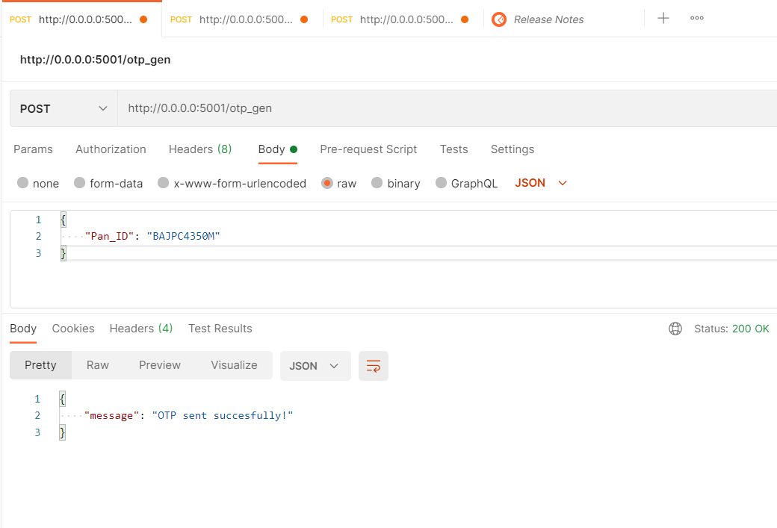
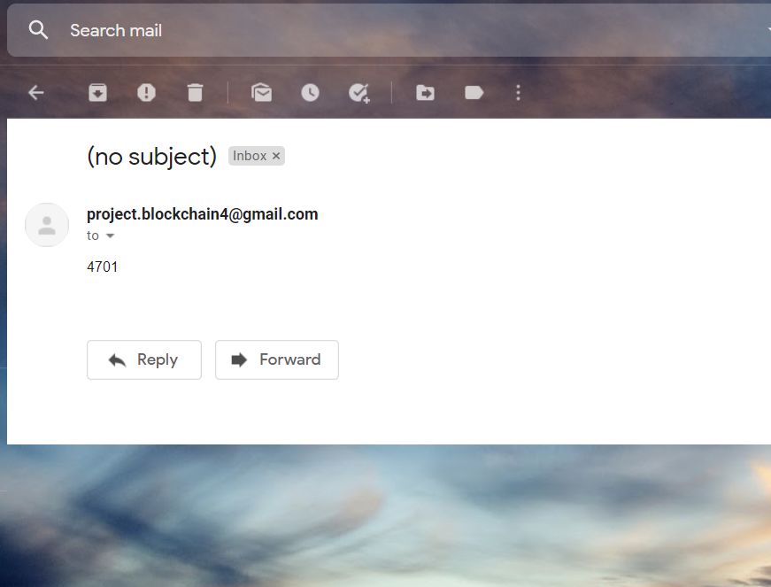
OTP GENERATION
10
BLOCKCHAIN | MARCH 2021
Note: For OTP generation, correct Pan Card ID needs to given

Slide 11
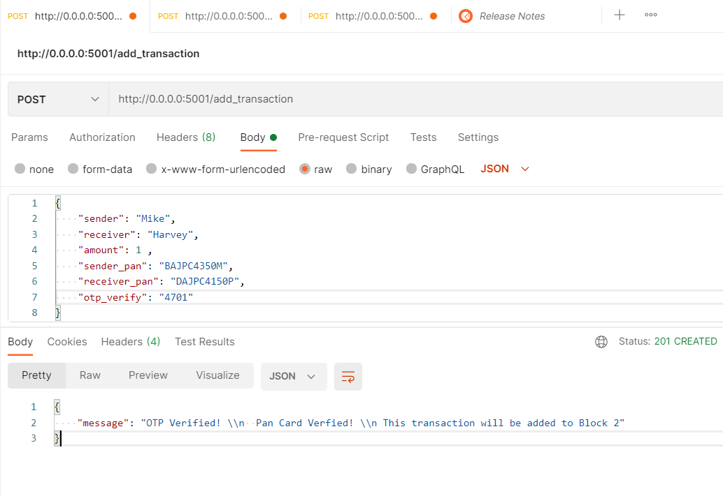

11
BLOCKCHAIN | MARCH 2021
TRANSACTION
Note: All the information passed in the add_transaction should be correct for transaction to successful

Slide 12
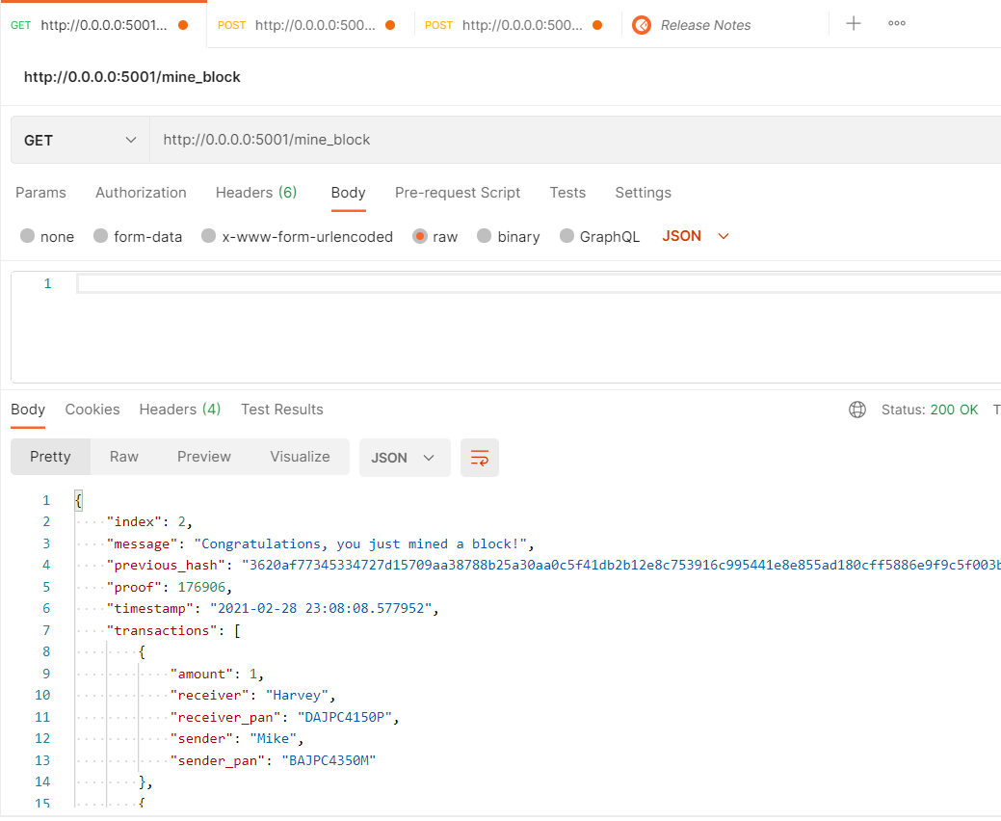
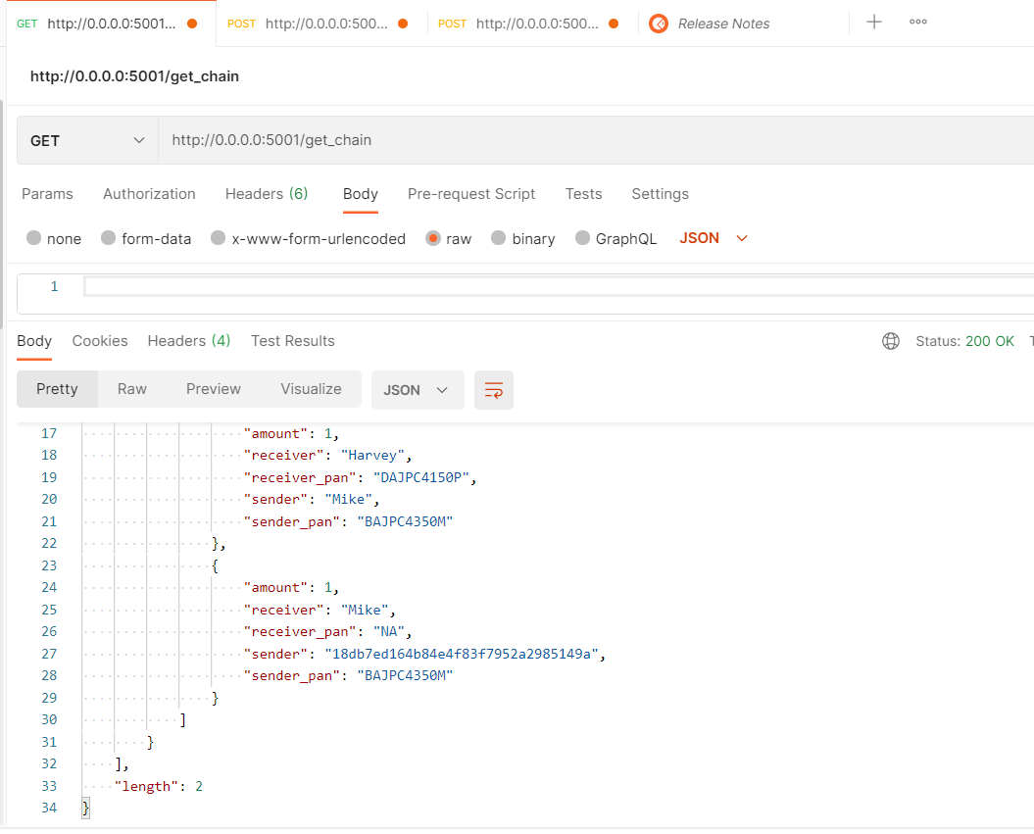
MINE BLOCK
12
BLOCKCHAIN | MARCH 2021

Slide 13
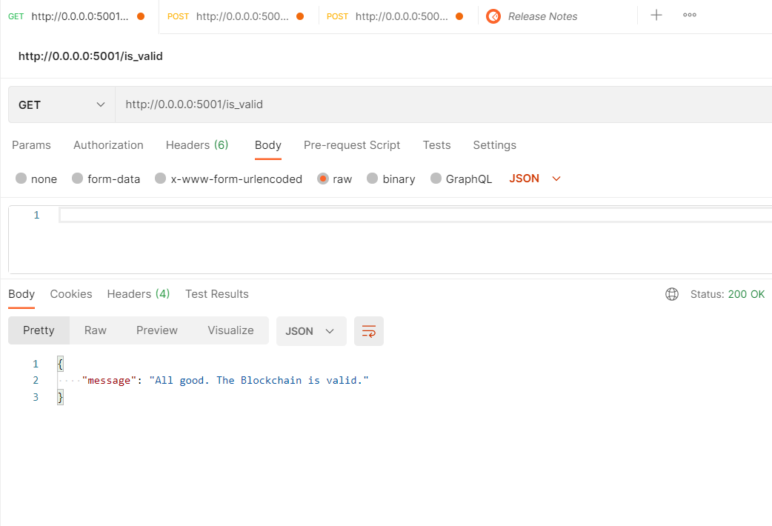
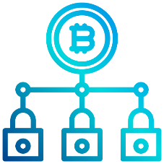

VALIDATION CHECK
13
BLOCKCHAIN | MARCH 2021

Slide 14
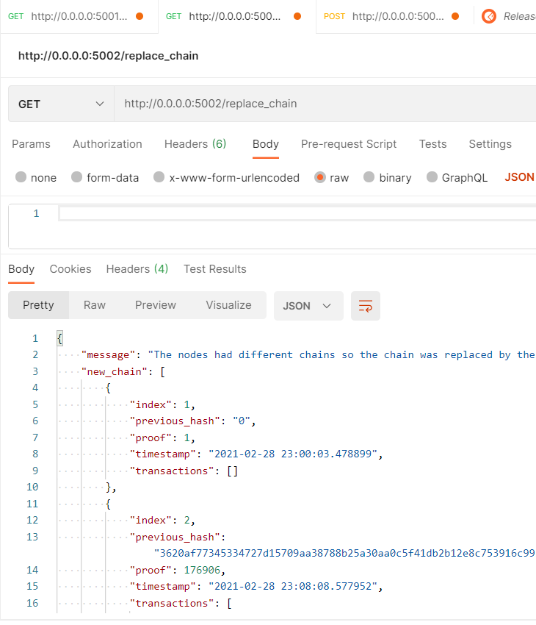
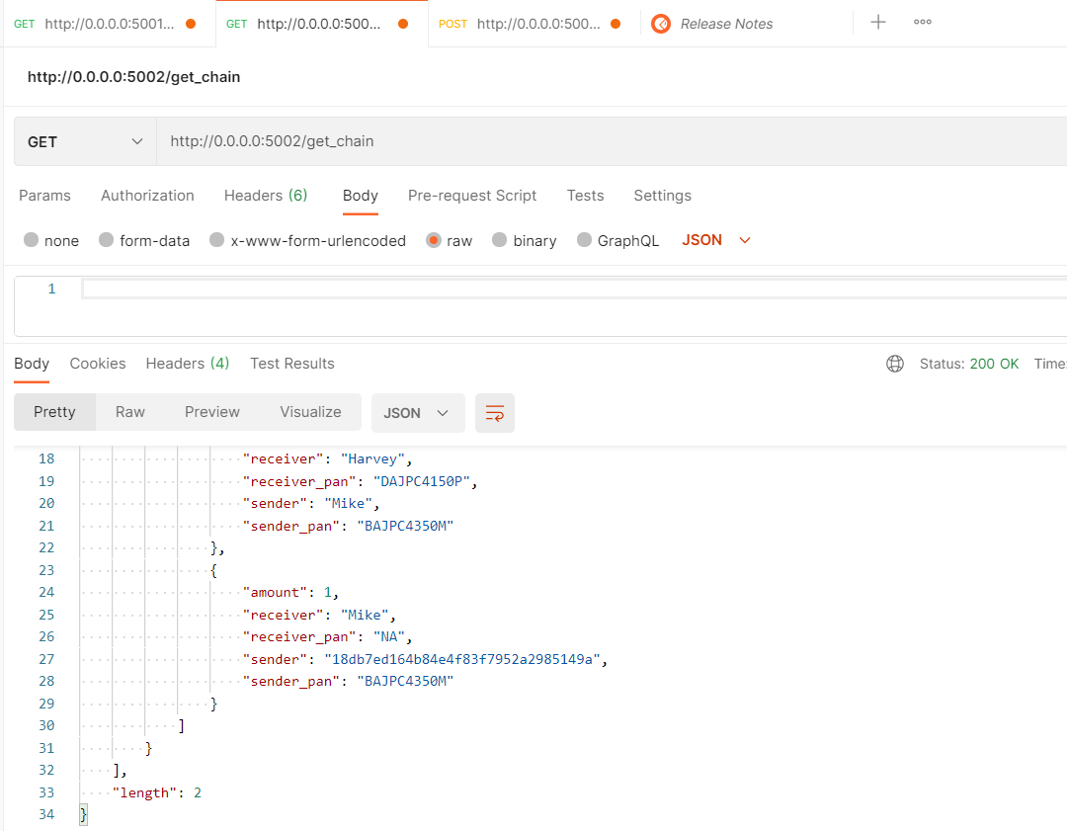
CHAIN REPLACEMENT
14
BLOCKCHAIN | MARCH 2021

Slide 15
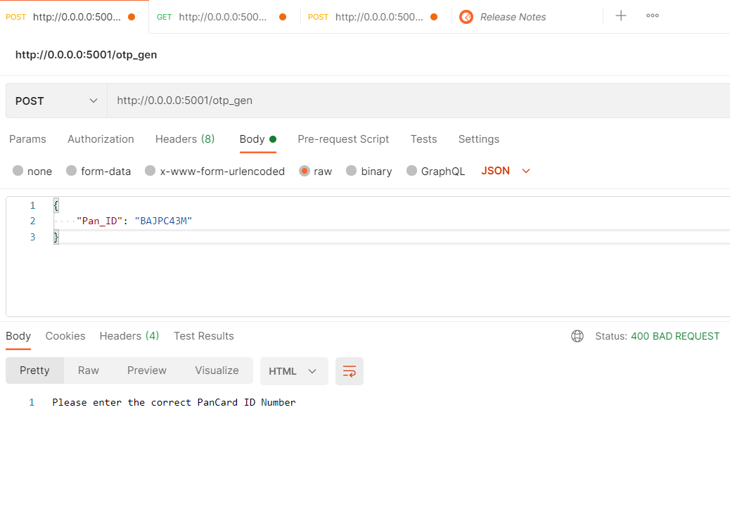
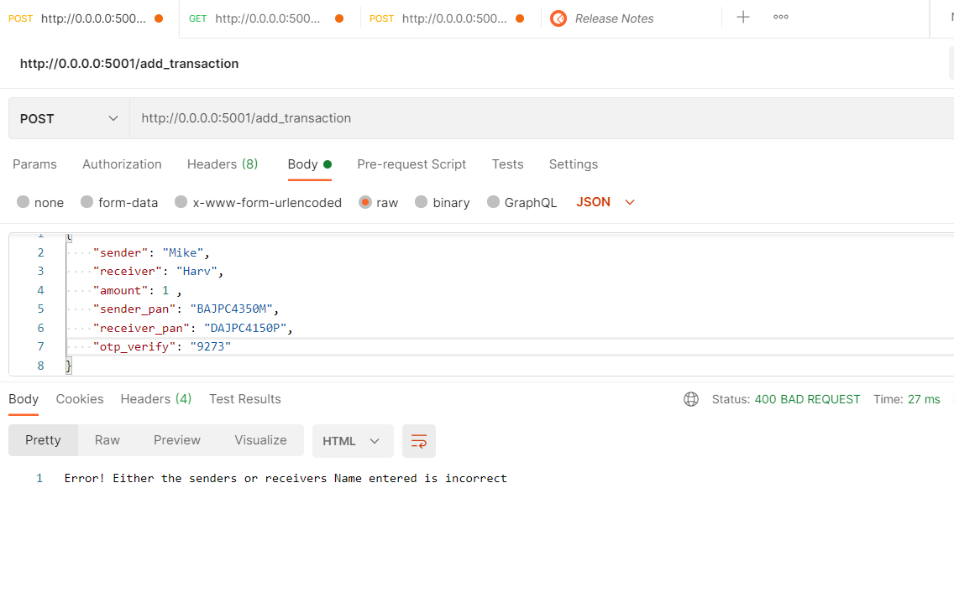
EXCEPTIONAL HANDLING
15
BLOCKCHAIN | MARCH 2021
INCORRECT PAN CARD FOR OTP GENERATION
SENDER’S/RECEIVER’S NAME IS INCORRECT

Slide 16
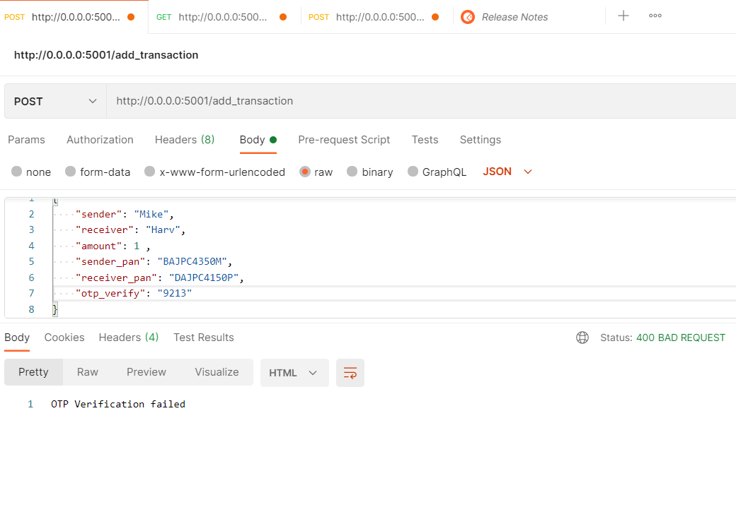
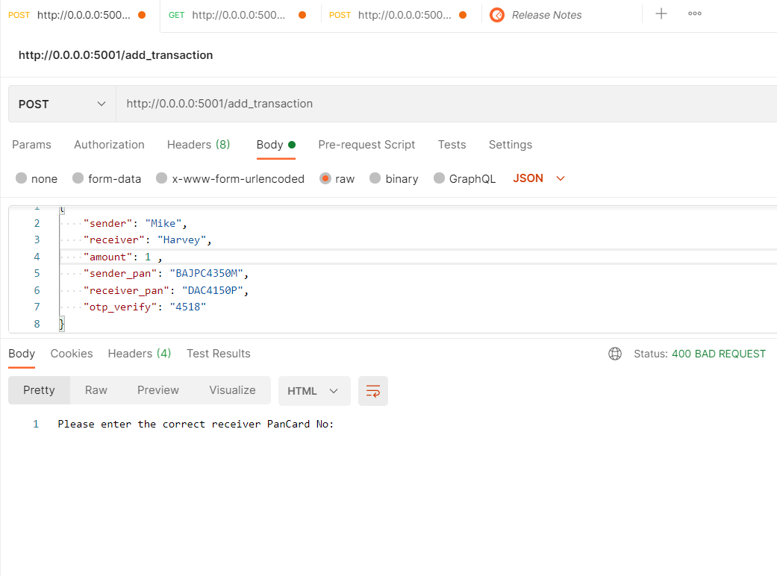
EXCEPTIONAL HANDLING
16
BLOCKCHAIN | MARCH 2021
OTP VERIFICATION FAILED
INCORRECT PAN CARD DETAILS FOR TRANASCTION INITIATION

Slide 17
FUTURE PROSPECTS
Security through Verification
A new token economy
Digital Identity solutions
Smart Contracts
17
BLOCKCHAIN | MARCH 2021

Slide 18

Thank You

